Slide 1
Delonix Regia Hotel Management System
CHAN ZHI MAI – 1301354E
Aaron lim jiekai – 1300647c
Zhiyong chew – 1306307h
Nurul Hidayah Hamzah – 1302901b

Slide 2
Introduction – CHAN ZHI MAI
Delonix Regia Hotel is not been doing well even though it is located at a good district.
Mr. Wang wants to have a Hotel Management System for their hotel.
Mr Wang expects to have an update on the project progress periodically.
Therefore, we will propose our system to Mr Wang by using Term of Reference, Project Plan and Project Schedule.

Slide 3
Objectives Room Booking Module – CHAN ZHI MAI
Offer online hotel rooms reservation for customer to make hotel room reservation with the hotel.
Integrate Information and save in a centralized database for easier insert, retrieve, update and delete.
Generate computerized report for business records such as cashier report.

Slide 4
Objectives Finance and accounting module – Aaron lim jiekai
Handles accounts, billing invoice, and view financial reports
System can manage different currencies to match with different foreign guest

Slide 5
Objectives Housekeeping module – Zhiyong chew
Room attendants and their supervisor can do better housekeeping
Fulfil hotel sanitation requirements more tactfully

Slide 6
Objectives Human resource module – nurul hidayah hamzah
allows functions such as leave applications, and generating payroll, reports and employee’s timetable/ timesheets.
record basic demographic and address data, selection, training and development, capabilities and skills management, compensation planning records and other related activities.
provides the ability to run applications and enter relevant data to applicable database fields, notify employers and provide position management and position control.

Slide 7
Objectives Human resource module – nurul hidayah hamzah
query their attendance record, apply for leave and check their work timetable from the system without asking the information from HR personnel.
lets supervisors to approve O.T and leave application requests from their subordinates through the system.
keep track of the employees’ attendance and their performance for job promotion or rise of salary.

Slide 8
Scope Room booking module – chan zhi mai
Availability status
Room reservation
Arrival list
Reservation list
Room status
Telephone calls
Check-in
Check-out
Departure list
Cashier report
Occupancy
billing

Slide 9
Scope finance and accounting module – aaron lim jiekai
Basic functions
Seized accountancy
Numerous automation
Third party management
Reconciliation
Multi’s
Numerous controls
Integration of modules
Financial reports
Analytic
budgeting

Slide 10
Scope housekeeping module – zhiyong chew
Basic functions
Activities
Housekeeping orders

Slide 11
Scope human resource module – nurul hidayah hamzah
Payroll
Database for employee information
Attendance records
Management of absences/leave application
Employee scheduling
Performance appraisal

Slide 12
Distribution of workload – chan zhi mai
Objectives/Deliverables | Members
Introduction | Chan Zhi Mai (1301354E)
Objectives of the Project | All
Room Booking Module | Chan Zhi Mai (1301354E)
Finance and Accounting Module | Aaron Lim JieKai (1300647C)
Housekeeping Module | ZhiYong Chew (1306307H)
Human Resource Module | Nurul Hidayah Hamzah (1302901B)
Scope of the Project | All
Room Booking Module | Chan Zhi Mai (1301354E)
Finance and Accounting Module | Aaron Lim JieKai (1300647C)
Housekeeping Module | ZhiYong Chew (1306307H)
Human Resource Module | Nurul Hidayah Hamzah (1302901B)

Slide 13
Distribution of workload – chan zhi mai
Objectives/Deliverables | Members
Distribution of Workload | Chan Zhi Mai (1301354E)
Constraints | ZhiYong Chew (1306307H)
Resources | Chan Zhi Mai (1301354E)
Product Positioning in the Market/Company | Aaron Lim JieKai (1300647C)
Approach and Methodology of the Project | Nurul Hidayah Hamzah (1302901B)

Slide 14
Constraints – zhiyong chew
Collaboration and integrating problem
Work load will be different as some might have more sub-features
Might not able to deliver the product stated due to time is limited
Software availability
manpower

Slide 15
Resources – chan zhi mai
Software:
1. Microsoft Office 2013
2. Microsoft Visual Studio 2013
3. Microsoft Security Essentials
4. SQL Management Studio
5. Tableau 8.3
Hardware:
Brother MFC-J470DW Printer
ASUS ET2321INTH All-In-One PC
Casio TE-2200 Cash Register with Honeywell MS-9520 Scanner Receipt Printer
Nets Terminal
Citibank Credit Card Terminal

Slide 16
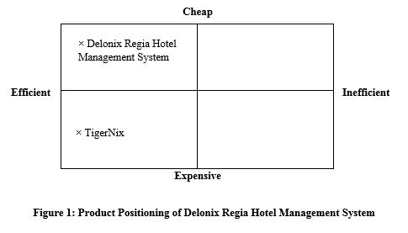
Product positioning – aaron lim jiekai

Slide 17
Approach and Methodology of the Project – nurul hidayah hamzah
WATERFALL MODEL:
model maintains that one should move to a phase only when it’s preceding phase is completed and perfected.
Phases of development in the waterfall model are thus discrete, and there is no jumping back and forth or overlap between them.

Slide 18
Assumption – zhiyong chew
• Assumed that the project will go on smoothly as time planned and be able to deliver the project to the hotel on time.
• Assumed that the manpower for the project will stay throughout the entire work schedule.
• Assumed that the hardware such as, computers, servers will deliver on time and able to configure as such for the project.
• Assumed that there are sufficient hardware and software to complete the project without failing.
• Assumed that there will be no issues upon integrating with the hotel and it will work as planned.

Slide 19
Definition and acronyms – chan zhi mai
HR – Human Resource
O.T. – Over Time
E.g. – Example
VAT – Value-added tax

Slide 20
Roles and responsibilities – chan zhi mai
Roles and Responsibilities | Members
Term of Reference
Introduction | Chan Zhi Mai (1301354E)
Objectives of the Project | All
Room Booking Module | Chan Zhi Mai (1301354E)
Finance and Accounting Module | Aaron Lim JieKai (1300647C)
Housekeeping Module | ZhiYong Chew (1306307H)
Human Resource Module | Nurul Hidayah Hamzah (1302901B)
Scope of the Project | All
Room Booking Module | Chan Zhi Mai (1301354E)
Finance and Accounting Module | Aaron Lim JieKai (1300647C)

Slide 21
Roles and responsibilities – chan zhi mai
Roles and Responsibilities | Members
Housekeeping Module | ZhiYong Chew (1306307H)
Human Resource Module | Nurul Hidayah Hamzah (1302901B)
Distribution of Workload | Chan Zhi Mai (1301354E)
Constraints | ZhiYong Chew (1306307H)
Resources | Chan Zhi Mai (1301354E)
Product Positioning in the Market/Company | Aaron Lim JieKai (1300647C)
Approach and Methodology of the Project | Nurul Hidayah Hamzah (1302901B)

Slide 22
Roles and responsibilities – chan zhi mai
Roles and Responsibilities | Members
Project Plan
Introduction
Objectives and scope of the project | Chan Zhi Mai (1301354E)
Assumptions and constraints | ZhiYong Chew (1306307H)
Definitions and acronyms | Chan Zhi Mai (1301354E)
Roles and responsibilities | Chan Zhi Mai (1301354E)
Estimates and project schedule
Work breakdown structure | All
Project schedule | All
Budget summary | Chan Zhi Mai (1301354E)
Risk management plan | All except Chan Zhi Mai (1301354E)

Slide 23
Work breakdown structure - all
Hotel Management System Project
1 Initiate Project
1.1 Develop Term of References
1.1.1 Define Scope and Requirement
1.1.2 Determine Project Team
1.1.2.1 Determine Project Manager
1.1.2.2 Determine Development Team
1.1.2.3 Determine Programming Team
1.1.3 Determine Project Positioning
1.1.4 Finalize Term of References and Gain Approvals
1.1.4.1 Consolidate Term of References
1.1.4.2 Hold Review Meeting
1.1.4.3 Revise Project Term of References
1.1.4.4 Gain Approvals

Slide 24
Work breakdown structure - all
2 Plan Project Plan
2.1 Develop Work Plan
2.1.1 Develop Work Breakdown Structure
2.1.2 Develop Project Staffing Plan
2.1.3 Develop Project Schedule
2.1.4 Develop Project Budget
2.1.5 Develop Risk Management Plan
2.2 Finalize Project Plan and Gain Approvals
2.2.1 Consolidate Project Plan
2.2.2 Hold Review Meeting
2.2.3 Revise Project charter
2.2.4 Gain approvals

Slide 25
Work breakdown structure - all
3 Installation and Configuration
3.1 Procure Hardware/Software
3.1.1 Install Development System
3.1.2 Install Live System
3.1.3 Configure System
4 Execute Project
4.1 Design Framework
4.1.1 Define framework stages and activities
4.1.2 Design framework content formats
4.1.3 Design web framework delivery tool

Slide 26
Work breakdown structure - all
4.2 Build the Framework
4.2.1 Write the framework content
4.2.2 Review framework content for quality
4.2.3 Build hotel management system
4.2.3.1 Room Booking Module
4.2.3.2 Finance Module
4.2.3.3 Housekeeping Module
4.2.3.4 Human Resource Module
4.3 Implement Framework
4.3.1 Test usability of web tool
4.3.2 Test usability of content
4.3.3 Adjust framework based on user feedback

Slide 27
Work breakdown structure - all
4.4 Test the Framework
4.4.1 Move framework to production environment
4.4.2 Announce availability of framework
4.5 Deployment
5 Close the Project
5.1 Maintenance

Slide 28
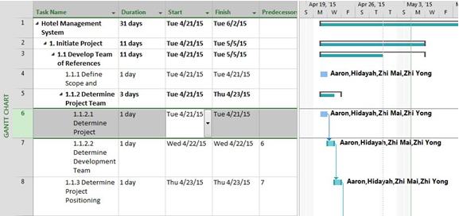
Project schedule - all

Slide 29
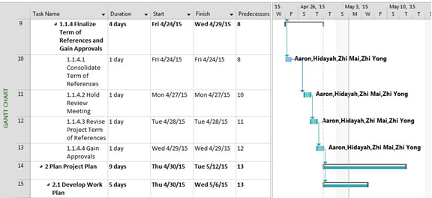
Project schedule - all

Slide 30
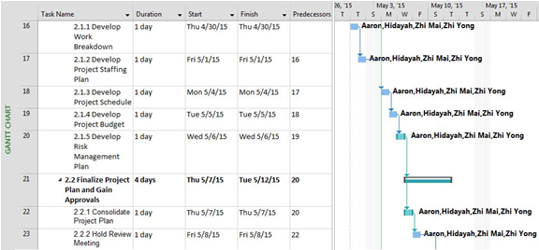
Project schedule - all

Slide 31
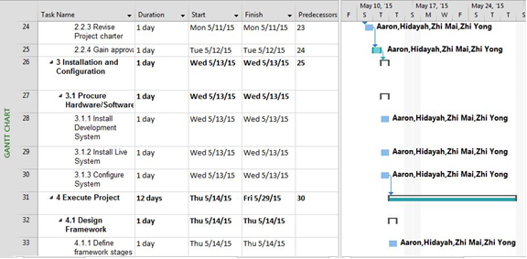
Project schedule - all

Slide 32
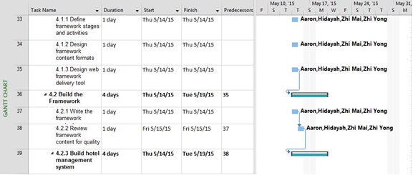
Project schedule - all

Slide 33
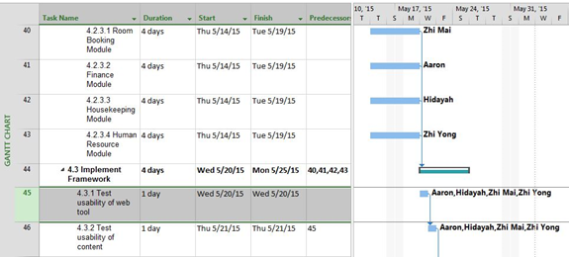
Project schedule - all

Slide 34
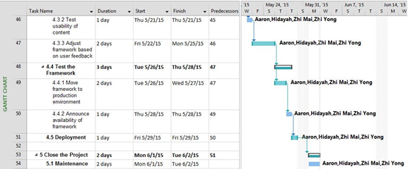
Project schedule - all

Slide 35
Budget summary – chan zhi mai
Delonix Regia Hotel Management System
Labour Expenses
Members | Salary ($)/month | Time needed (Months) | Total Salary ($)
Chan Zhi Mai | 1,000 | 2 | 2,000
Aaron Lim JieKai | 1,000 | 2 | 2,000
ZhiYong Chew | 1,000 | 2 | 2,000
Nurul Hidayah Hamzah | 1,000 | 2 | 2,000
Subtotal: |  |  | 8,000
Hardware Expenses
Resources | Cost ($) /quantity | Quantity | Total Cost ($)
Brother MFC-J470DW Printer | 218.00 | 1 | 218.00
ASUS ET2321INTH All-In-One PC | 1499.00 | 1 | 1499.00

Slide 36
Budget summary – chan zhi mai
Delonix Regia Hotel Management System
Casio TE-2200 Cash Register with Honeywell MS-9520 Scanner Receipt Printer | 698.00 | 1 | 698.00
Nets Terminal | 40.00 | 1 | 40.00
Citibank Credit Card Terminal | 246.00 | 1 | 246.00
Subtotal: |  |  | 2701.00
Software Expenses
Resources | Cost ($) /quantity | Quantity | Total Cost ($)
Microsoft Office 2013 | FREE | 1 | FREE
Microsoft Visual Studio | FREE | 1 | FREE
Microsoft Security Essentials | FREE | 1 | FREE
SQL Management Studio | FREE | 1 | FREE

Slide 37
Budget summary – chan zhi mai
Delonix Regia Hotel Management System
Tableau 8.3 | FREE | 1 | FREE
Subtotal: |  |  | FREE
Other Expenses
Resources | Cost ($) /quantity | Quantity | Total Cost ($)
Credit Card Terminal Annual Fees | 385.00 | 1 | 385.00 (Annually)
Nets Terminal Annual Fees | 456.00 | 1 | 456.00 (Annually)
Subtotal: |  |  | 841.00
Total Cost of the project: |  |  | 11542.00

Slide 38
RISK MANAGEMENT PLAN – ALL EXCEPT CHAN ZHI MAI
Financial risk
the hotel may not achieve its business and profit margins due to cash-flow issue.
To reduce the, the hotel may use the approach to come up with promotions, discounts, lucky draws to attract customers to continue to visit the hotel
and if such approach are good, customers will eventually use their mouth-to-mouth to let more people know about the hotel.

Slide 39
RISK MANAGEMENT PLAN – ALL EXCEPT CHAN ZHI MAI
Reputational Risk
competitive is growing in the fast market nowadays.
The likelihood of this risk arising is moderate as long as the hotel provides customers great service.
To reduce the risk from arising at any point of time, the hotel can ensure that all staffs are well-trained and provide good services to customers at any time.

Slide 40
RISK MANAGEMENT PLAN – ALL EXCEPT CHAN ZHI MAI
Safety Risk
People may injured themselves within the hotel premises
The likelihood of this risk arising is likely to happen as people sometimes are not that careful and thus leading to injuries.
To reduce the risk, the hotel may engage employees to attend safety risk courses that can train the employees to help handle such situation

Slide 41
RISK MANAGEMENT PLAN – ALL EXCEPT CHAN ZHI MAI
Information Systems Risk
Failure in the management system will be deadly as the hotel rely heavily on technologies and cause operation to be delayed
Valuable information are stored in the management system and any inappropriate or unauthorized access will cause it to be lost
To reduce this risk, the Hotel have to ensure at least monthly system updates and inspections to prevent any system disruption
have to implement a variety of security measures in order to maintain the safety of personal customer information and to prevent outsiders from hacking in into the system.

Slide 42
RISK MANAGEMENT PLAN – ALL EXCEPT CHAN ZHI MAI
Technology Risk
unable to keep pace with developments in technology could damage operation or competitive position.
technologies and systems must be refined, updated or replaced with more advanced systems on a regular basics.
If the hotel is unable to do as quickly as compared to competitors or could not afford to change or update the system, it will cause the business to suffer.
To reduce the risk from arising, hotel can find technologies that is cheap and easy to update and also software that is flexible to implement news features or update.

Slide 43
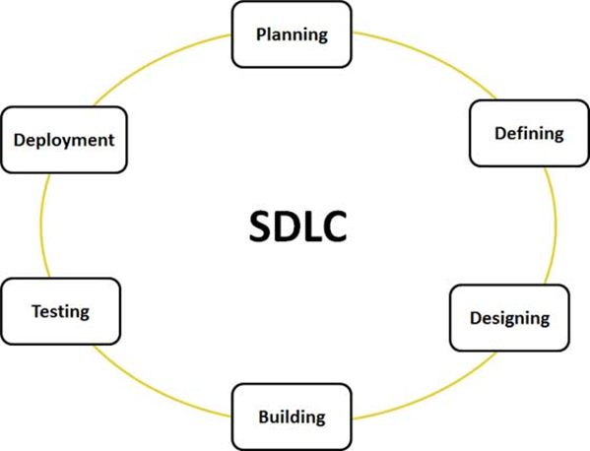
SOFTWARE DEVELOPMENT LIFE CYCLE – CHAN ZHI MAI
SDLC STAGES – PLANNING TO DEPLOYMENT
a framework or a process used by software industry to define tasks performed at each step in the software development process.
SDLC is a structure followed by a development team within the software organization.
It consists of a detailed plan describing how to design, develop, maintain, replace and alter or enhance specific software.

Slide 44
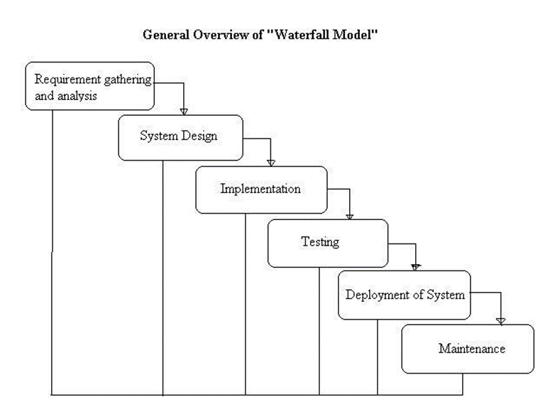
Waterfall model – CHAN ZHI MAI
WATERFALL MODEL PHRASES
also referred as a linear-sequential life cycle model.
each phrase must be fully completed before the next phrase can begin.
usually used for small projects and there are no uncertain requirements.
At the end of each phrase, a review takes place to determine if the project is on the right path and whether or not to continue or discard the project.

Slide 45
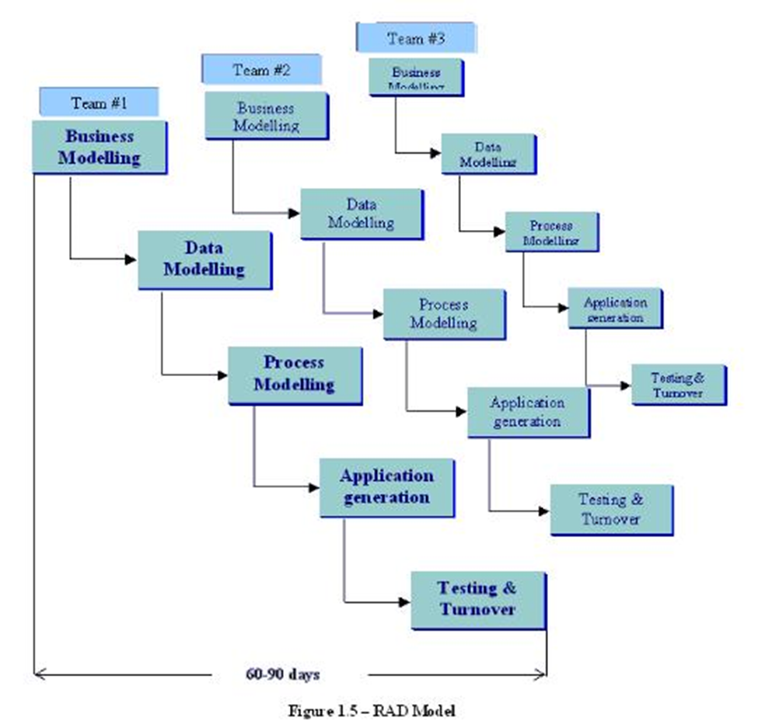
RAPID APPLICATION DEVELOPMENT (RAD) model – CHAN ZHI MAI
RAD MODEL PHRASES
a type of incremental model.
The components and functions are developed in parallel as if they were mini projects.
The developments are time-boxed, delivered and then assembled into a working prototype.
This can quickly give the customer something to see and use so as to provide feedback regarding the deliver and their requirements.

Slide 46
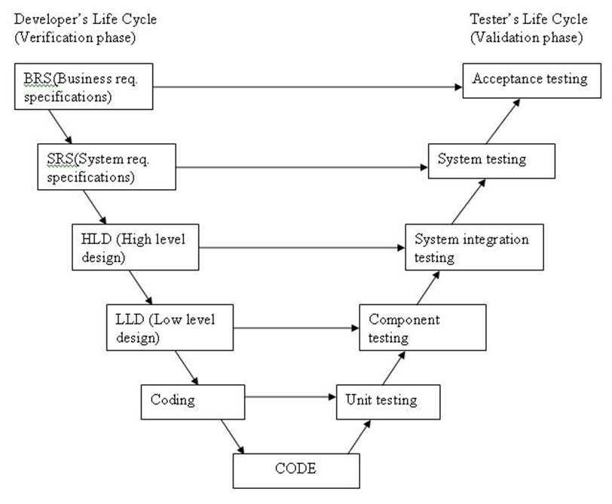
VERIFICATION AND VALIDATION model (v) – CHAN ZHI MAI
V MODEL PHRASES
a sequential path of execution of process.
Each phase must be completed before the next phase begins.
Testing of the product is planned in parallel with a corresponding phase of development.

Slide 47
SOFTWARE DEVELOPMENT LIFE CYCLE – Aaron lim jiekai
Six phases in SDLC:
Requirement gathering and analysis
Implementation
Testing
Documentation
Deployment
Maintenance
Framework defining tasks performed at each step in the software development process
A structure followed by a development team within the software organization.
Consists of a detailed plan describing how to develop, maintain and replace specific software
The life cycle defines a methodology for improving the quality of software and the overall development process

Slide 48
Waterfall Model – Aaron lim jiekai
First process model to be introduced.
Referred to as a linear-sequential life cycle model.
Each phase must be completed fully before the next phase can begin.
Used for project which is small and there are no uncertain requirements.
Testing starts only after the development is complete and in waterfall model phases do not overlap

Slide 49
Waterfall Model – Aaron lim jiekai
Advantages of waterfall model:
Simple and easy to understand and use
Easy to manage due to the rigidity of the model as each phase has specific deliverables and a review process.
Waterfall model works well for smaller projects
Model phases are processed and completed one at a time as phases do not overlap.
Disadvantages of waterfall model:
High amounts of risk and uncertainty.
Poor model for long and ongoing projects.
Not a good model for complex and object-oriented projects.
No working software is produced until late during the life cycle.

Slide 50
Incremental Model – Aaron lim jiekai
Divided into various builds and multiple development cycles take places here, making the life cycle a “multi-waterfall” cycle.
Cycles are then divided up into smaller so as to manage modules easily.
Each module will pass through the requirement, design, implementation and lastly the testing phases
Each subsequent release of the module adds function to the previous release and the process continues until the complete system is achieved.

Slide 51
Incremental Model – Aaron lim jiekai
Advantages of Incremental Model:
Generates working software quickly and early during the software life cycle.
Less costly to change scope and requirements.
It is easier to test and debug during a smaller iteration.
Customer can respond to each built.
Lowers initial delivery cost.
Disadvantages of Incremental Model:
Need good planning and design.
Need a clear and complete definition of the whole system before it can be broken down and built incrementally.

Slide 52
Agile Model – Aaron lim jiekai
Is also a type of incremental model
Software is developed in incremental and rapid cycles.
Results in small incremental releases with each release building on previous functionality.
Each release is thoroughly tested to ensure that the software quality is maintained and it is also used for time critical applications.
Example of agile model is extreme programming(XP)

Slide 53
Agile Model – Aaron lim jiekai
Advantages of Agile Model:
Customer satisfaction by rapid, continuous delivery of useful software.
Customers, developers and testers constantly interact with each other.
Working software is delivered frequently
Late changes in requirements can be done
Disadvantages of Agile Model:
Difficult to assess the effort required at the beginning of the software development life cycle if the software deliverables are larges.
Lack of emphasis on necessary designing and documentation.
The project can easily get taken off track if the customer representative is not clear with what is the final outcome that they want.

Slide 54
SOFTWARE DEVELOPMENT LIFE CYCLE – ZHIYONG CHEW
Framework that define tasks performed at each step in the software development process
A structure that is followed by a development team within the software organization
Used in systems engineering, information systems and software engineering to describe a process for planning creating, testing and deploying
Software Development Life Cycle Phases:
Requirement gathering and analysis
Design
Implementation or coding
Testing
Deployment
Maintenance

Slide 55
SOFTWARE DEVELOPMENT LIFE CYCLE – ZHIYONG CHEW
Requirement gathering and analysis
Requires business requirement that must be gathered
Main focus for project managers and stake holders
Conduct meetings to determine the requirements
After requirements are gathered, it will be analyzed in the system and development is also studied
Design
Prepares the system, software design that were studied in the first phase
Specify design hardware and system requirements that helps in defining the overall system architecture
Serve as the input for the next phase model

Slide 56
SOFTWARE DEVELOPMENT LIFE CYCLE – ZHIYONG CHEW
Implementation or coding
Receives system design documents
The work will be divided in modules or units and the actual coding will be started
Code will be produced and it will be the main focus for developers
The longest phase of the SDLC
Testing
Making sure product is solving the addressed and gathered during the requirement phase once the code is developed
Unit testing, integration testing, system testing and acceptance testing are done in this phase

Slide 57
SOFTWARE DEVELOPMENT LIFE CYCLE – ZHIYONG CHEW
Deployment
Deploy the product to the customer for their usage after all successful testing are done
Maintenance
Take care of problems once customer’s meets actual problem when they starts using the developed system

Slide 58
Waterfall model – ZHIYONG CHEW
Refers to linear-sequential life cycle model. Each phase must be completed fully first before the next phase can begin
Used for project which is small with no other uncertain requirements
A review will take place to determine if the project is on the right path one the first phase end
Testing only starts after the development is completed
Does not overlap

Slide 59
Waterfall model – ZHIYONG CHEW
Advantages of Waterfall Model:
Simple and easy to understand and use
Each phase has specific deliverables and a review process thus making it easy to manage
Waterfall model works well in smaller projects
Disadvantages of Waterfall Model:
It is hard to change something that was not well-thought in the concept stage once the application is in the testing stage
High amounts of risk and uncertainty
Poor model for long and ongoing projects

Slide 60
Iterative Model – ZHIYONG CHEW
Does not attempt to start with a full specification of requirements
Development begins by specifying and implementing just part of the software, which then will be reviewed in order to identify further requirements.
Process will then be repeated thus, producing a new version of the software for each cycle of the model

Slide 61
Iterative Model – ZHIYONG CHEW
Advantages of Iterative Model:
Detect defects at early stages as iterative model allows building and improving the product step by step
Less time is spent on documenting and more time given for designing
Get reliable user feedback when presenting sketches and blueprints of the product to users for their feedback
Disadvantages of Iterative Model:
Each phase of iterative is rigid with no overlaps
Expensive system architecture or design as not all requirements are gathers up front for the entire lifecycle

Slide 62
RAD Model – ZHIYONG CHEW
A type of incremental model
Components or functions are developed in parallel that acts like they were mini projects
Developments are time boxed, delivered and then assembled into a functioning prototype.
Quickly give the customer something to see and use so to provide feedback regarding the delivery and the requirements

Slide 63
RAD Model – ZHIYONG CHEW
Advantages of RAD Model:
Reduced development time
Encourages customer feedback
Increases the reusability of components
Disadvantages of RAD Model:
Requires skilled developers or designers
Not applicable for cheaper projects as the cost of modelling and automated code generation is very high
Only system that can be modularized, can only be built using RAD model

Slide 64
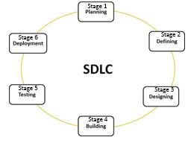
SOFTWARE DEVELOPMENT LIFE CYCLE – NURUL HIDAYAH HAMZAH
PHASES IN SDLC
Series of steps, or phases
Provide a model for the development and lifecycle management of an application
Cost-efficient
Effective
High quality

Slide 65
Agile Model – NURUL HIDAYAH HAMZAH
Focuses on process adaptability and customer satisfaction
Rapid delivery of working software product
Interactive
Incremental
Used for time critical applications
Tasks are divided to small time frames to deliver specific features for a release
Managing time due to its flexibility and adaptability
ADVANTAGES:
Functionality can be developed rapidly and demonstrated.
Resource requirements are minimum.
Suitable fixed or changing requirements.
Minimal rules, documentation easily employed
Little planning required
Easy to manage

Slide 66
V-Model – NURUL HIDAYAH HAMZAH
Verification and Validation model
V-shaped life cycle is a sequential path of execution of processes
Each phase must be completed before the next phase begins
Testing of the product is planned in parallel with a corresponding phase of development
ADVANTAGES:
Simple and easy to use.
Testing activities like planning, test designing happens well before coding. This saves a lot of time. Hence higher chance of success over the waterfall model.
Proactive defect tracking – that is defects are found at early stage.
Avoids the downward flow of the defects.
Works well for small projects where requirements are easily understood.

Slide 67
RAD mODEL – NURUL HIDAYAH HAMZAH
Stands for Rapid Application Development
Type of incremental model
Developed in parallel – for mini projects
Customers are able to see and use this to provide feedback regarding the delivery and their requirements
ADVANTAGES:
Reduced development time.
Increases reusability of components
Quick initial reviews occur
Encourages customer feedback
Integration from very beginning solves a lot of integration issues.

